Slide 1
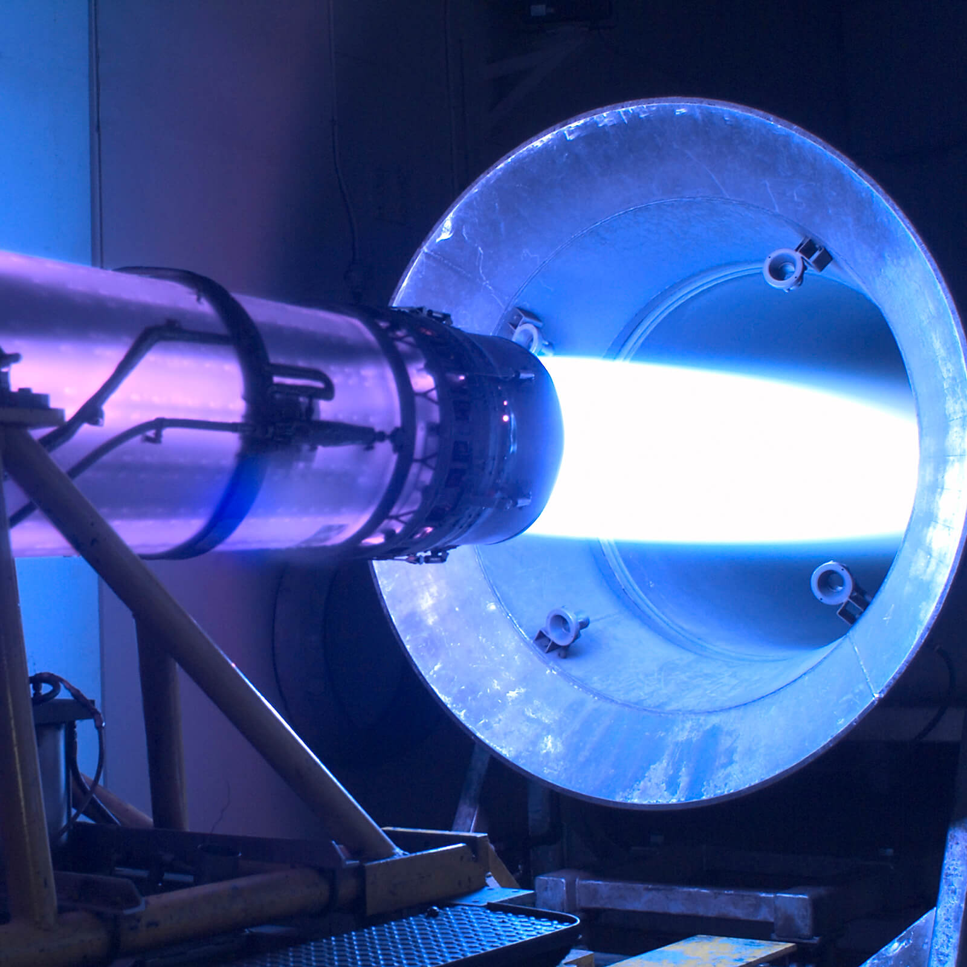
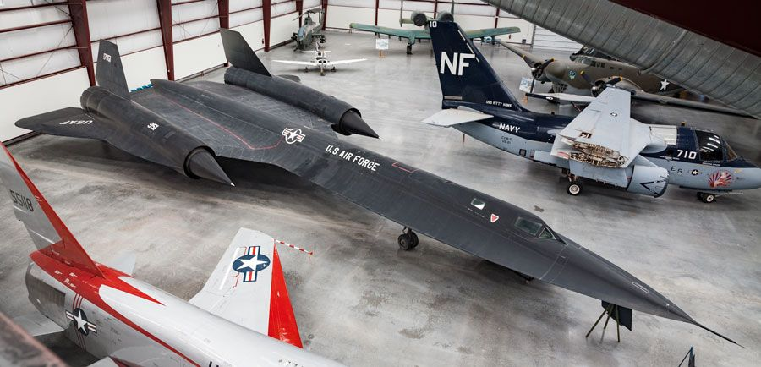

Slide 2
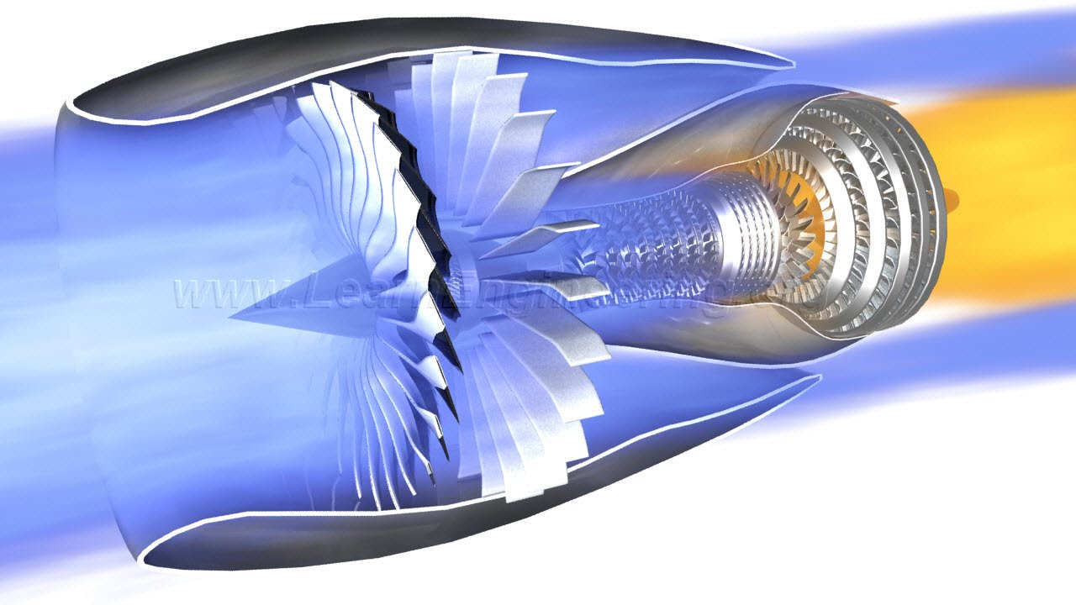
Jet Engines
Jet engines are a class of propulsion engines that utilize Newton's third law of motion to generate forward thrust. This is accomplished by exhausting high-temperature, high-pressure gases to create propulsion. Jet engines can be classified into different types such as turbojet engines, turbofan engines, ramjet engines, ion propulsion, etc. each with its own unique design and application. Jet engines are considered to be a critical technology that has significantly impacted modern aviation and transportation by enabling faster and more efficient air travel.

Slide 3
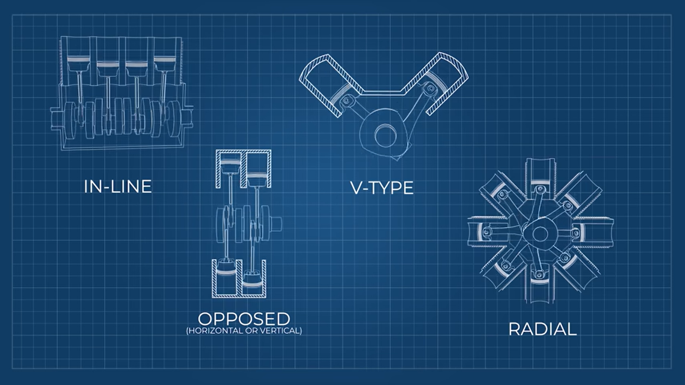
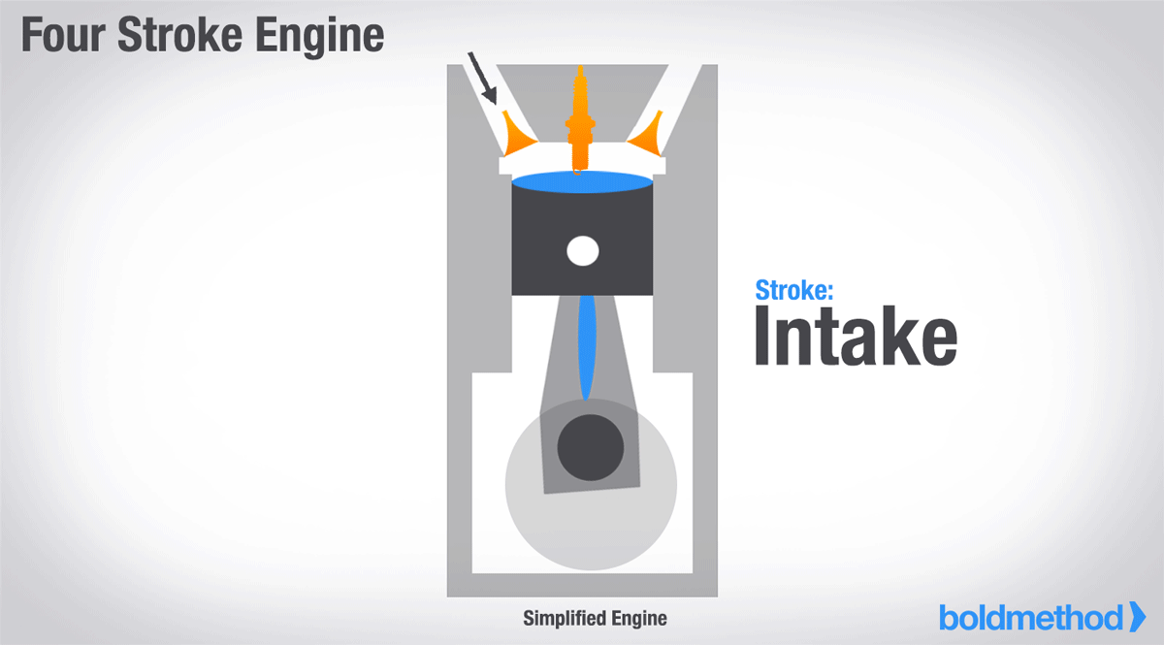
1.Piston Engines
Piston engines operate through a series of four processes: intake, compression, combustion, and exhaust. During the intake stroke, a mixture of air and fuel is drawn into the cylinder. In the compression stroke, the mixture is compressed by the rising piston. In the combustion stroke, the compressed mixture is ignited, causing an explosion that drives the piston down. Finally, in the exhaust stroke, the spent gases are expelled from the cylinder.
Piston engines can be categorized into four types based on the arrangement of the cylinders: inline, opposed, and V-type, and radial engines. In an inline engine, the cylinders are arranged in a single row. In an opposed engine, the cylinders are arranged in two rows on opposite sides of the crankshaft. In a V-type engine, the cylinders are arranged in two rows at an angle to each other, resembling a "V" shape. In a radial engine, the cylinders are arranged in a circle around the crankshaft.
The arrangement of the cylinders can have an impact on the engine's performance, efficiency, and size, making it an important consideration in engine design.

Slide 4
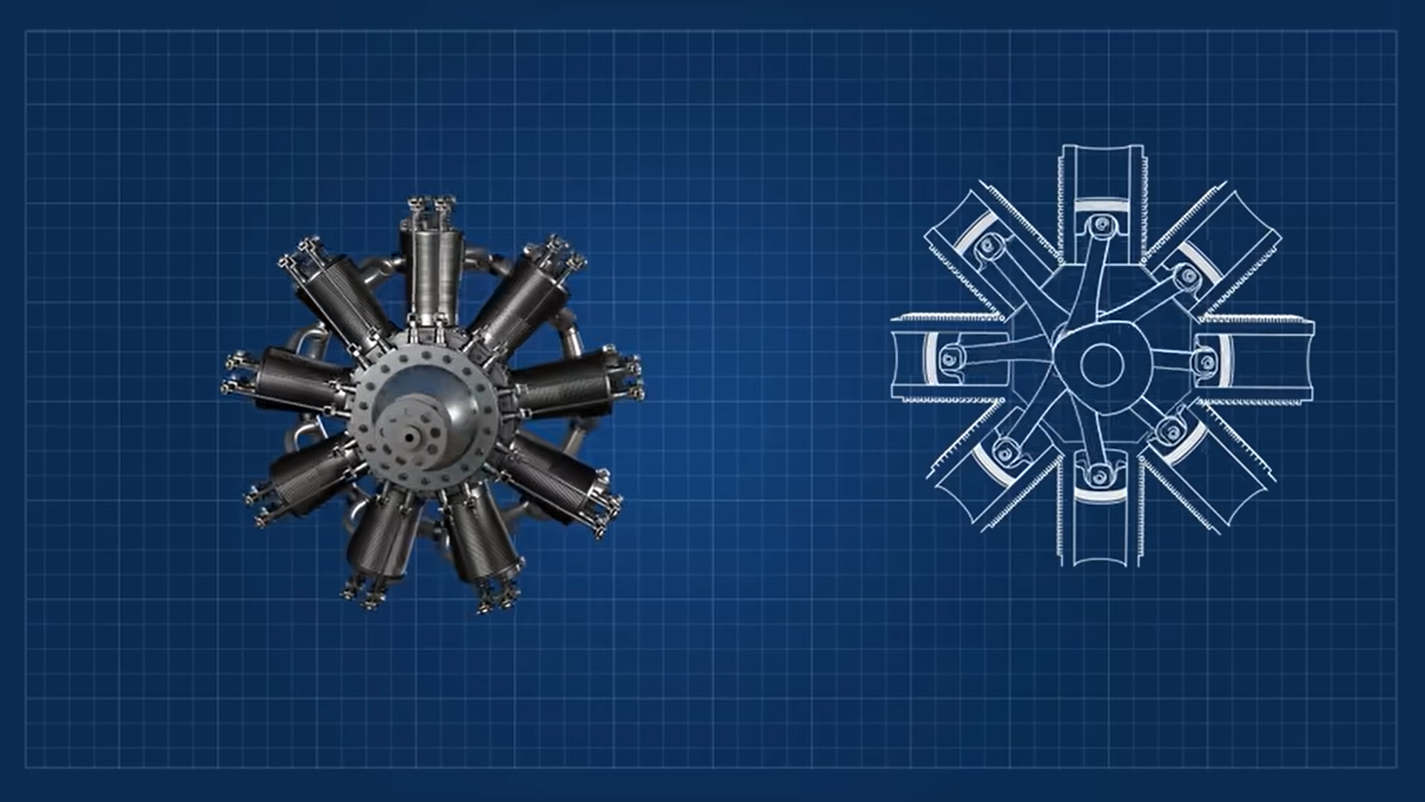
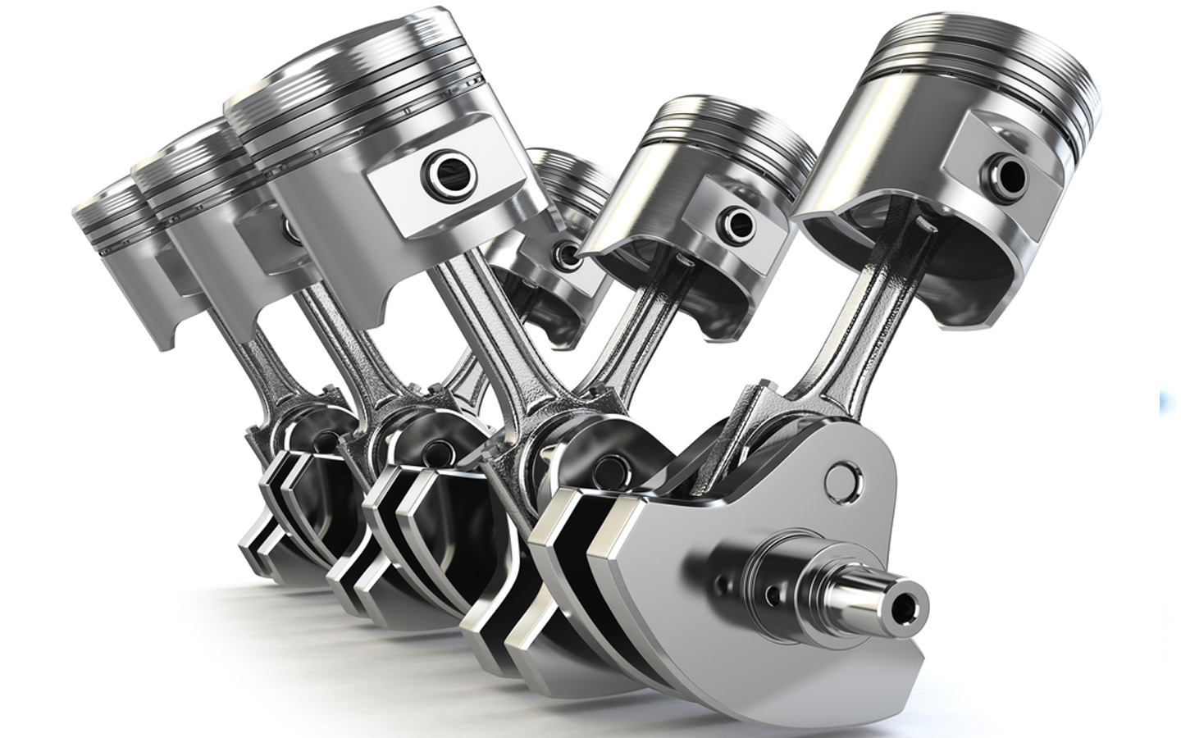
Radial and V-Type Pistons:
The radial engine, due to its unique arrangement of cylinders, has the advantage of exposing all cylinders directly to the air flow, which eliminates the need for an additional cooling system. This can simplify the design of the engine and reduce weight and complexity. However, the radial engine also has a greater air drag in comparison to other engine systems due to the large frontal area that is presented to the oncoming air.
The V-type engine, due to its angled cylinder arrangement, can be slimmer in design and offer better aerodynamics in comparison to some other engine systems. This can result in reduced air drag, which can improve overall efficiency and performance, particularly at higher speeds. However, this design also presents a challenge for cooling the engine as the cylinders are arranged in a compact configuration, which can limit the amount of air that can flow around them for cooling. As a result, V-type engines typically rely on more complex cooling systems to maintain proper operating temperatures.

Slide 5
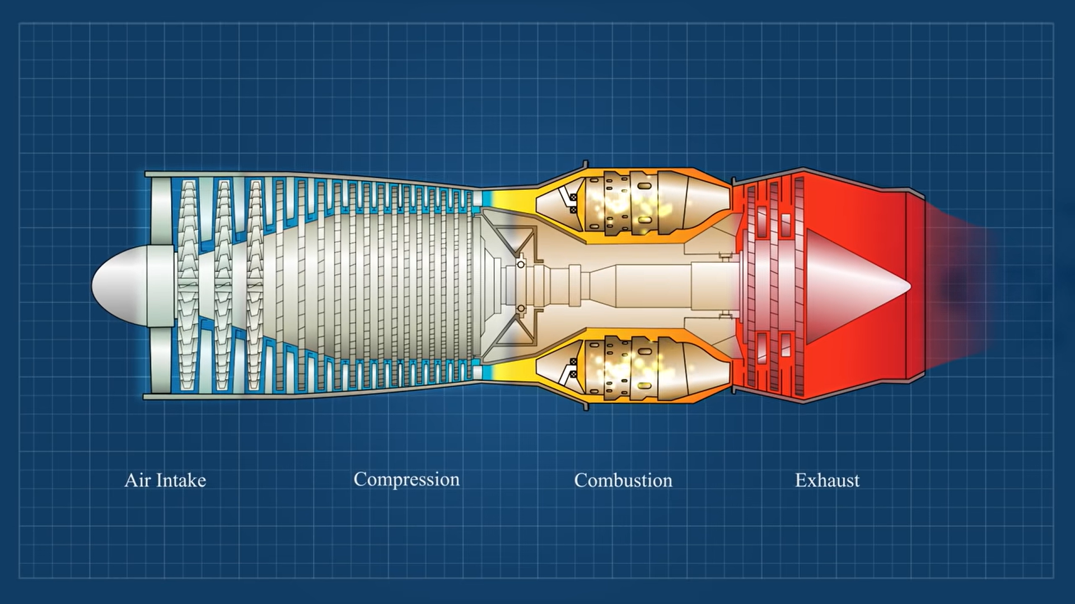
2. Turbo jet Engines
While piston engines can be used in a variety of applications, including aircraft, they do have some limitations when it comes to achieving high speeds.
In order to achieve higher speeds, rocket engines can be used. However, rocket engines are not very efficient in terms of fuel consumption and are typically only used in situations where a high amount of thrust is needed, such as in spacecraft.
So, Turbo jet engines were developed to solve this problem.
Turbo Jet engines are internal combustion engines that work on the Brayton cycle. The Brayton cycle is a thermodynamic cycle that involves four processes: compression, heating, expansion, and cooling.
The four main components of a turbojet engine are the compressor, combustion chamber, turbine, and nozzle

Slide 6
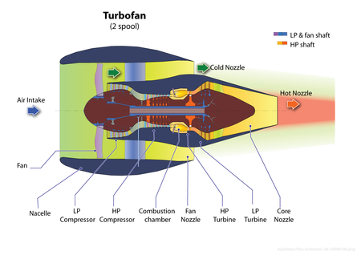
Turbofan Engine:
A turbofan engine is a type of gas turbine engine that is commonly used in aircraft propulsion. It is similar to a turbojet engine in that it uses a compressor to compress air, which is then mixed with fuel and ignited to produce a high-velocity exhaust stream that generates thrust. However, a turbofan engine also features a fan at the front of the engine, which is driven by the same turbine that powers the compressor.

Slide 7
Turbojet Engine:
A turbojet engine is a type of gas turbine engine that is commonly used in aircraft propulsion. It works by compressing incoming air with a compressor, mixing it with fuel, and then igniting the mixture in a combustion chamber to produce high-pressure, high-velocity exhaust gases. The exhaust gases then flow through a turbine, which powers the compressor and other accessories, before exiting the engine through a nozzle to generate thrust.

Slide 8
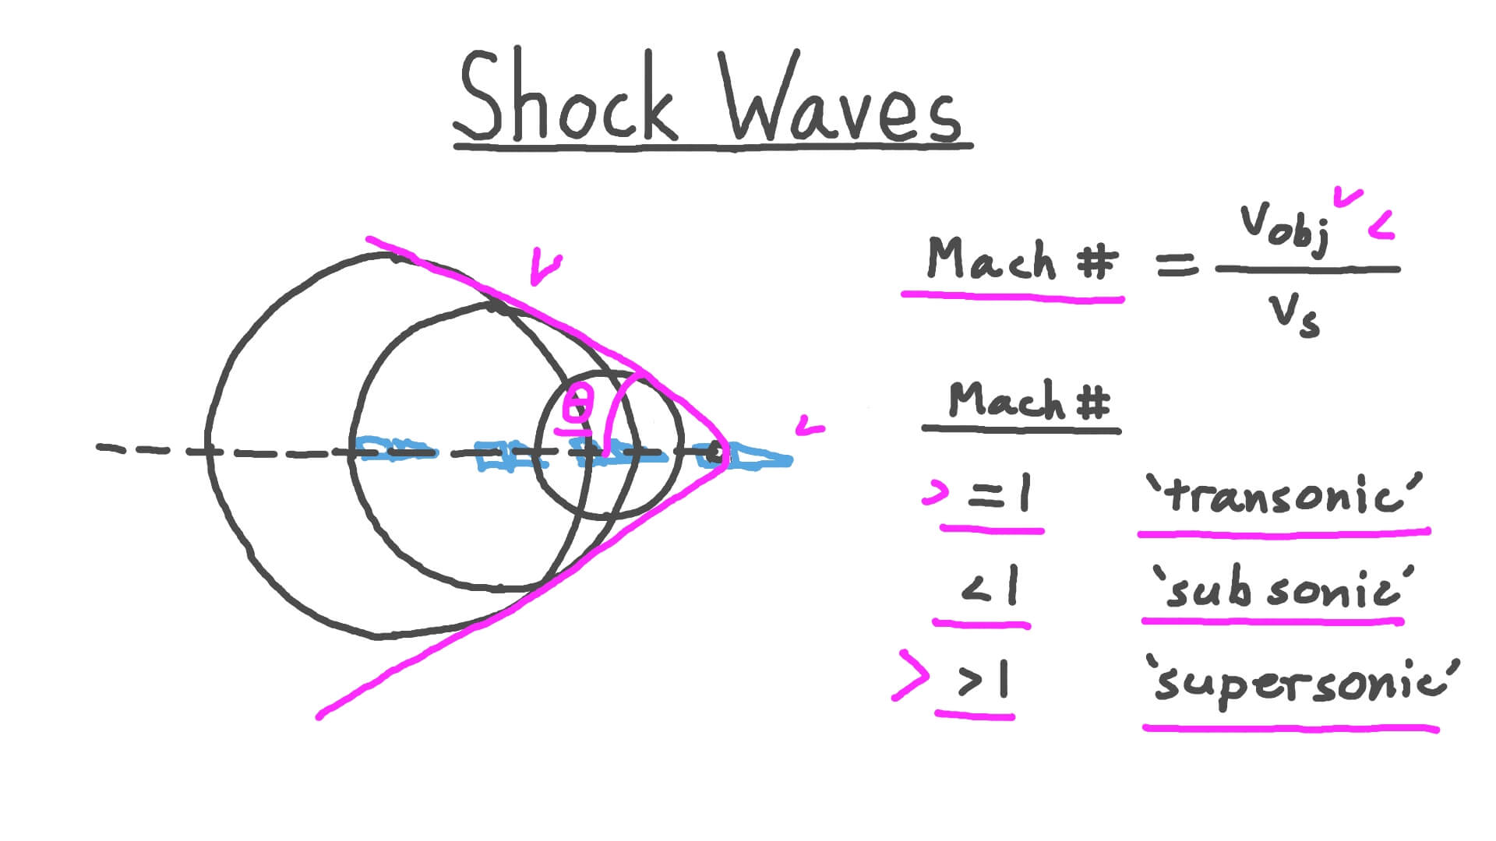
Ramjet Engines:-
Shock Waves:
In physics, a shock wave (also spelled shockwave), or shock, is a type of propagating disturbance that moves faster than the local speed of sound in the medium. Like an ordinary wave, a shock wave carries energy and can propagate through a medium but is characterized by an abrupt, nearly discontinuous, change in pressure, temperature, and density of the medium
In Purple line region, due to constructive interference of sound waves, amplitude of sound increases which results in shock waves.
Shock waves are characterized by a very thin region of extremely high pressure and temperature, known as the shock front. The thickness of the shock front can vary depending on the properties of the medium and the speed of the object creating the shock wave, but it is typically on the order of a few nanometers(approx. 200nm).

Slide 9
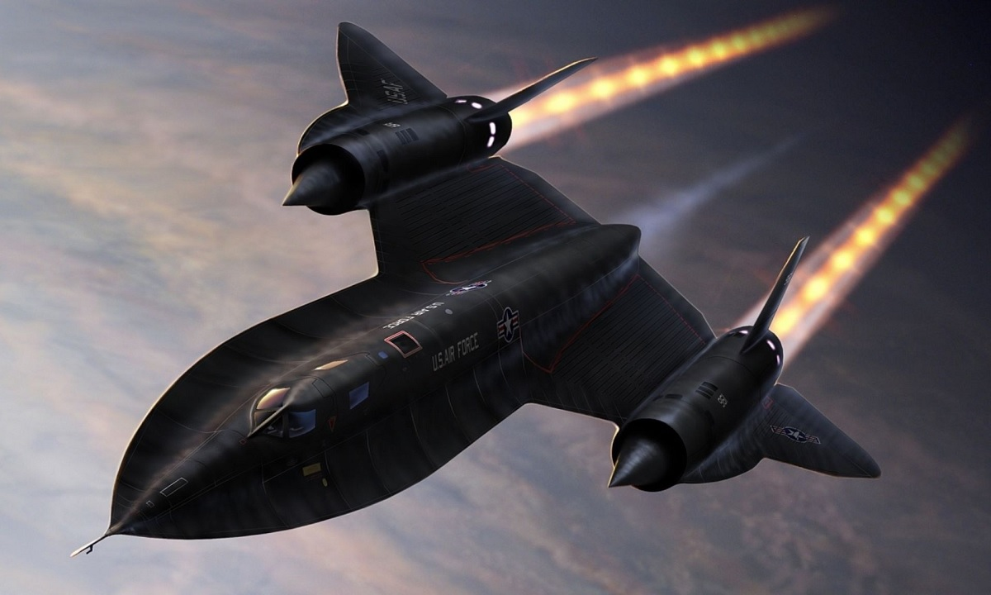
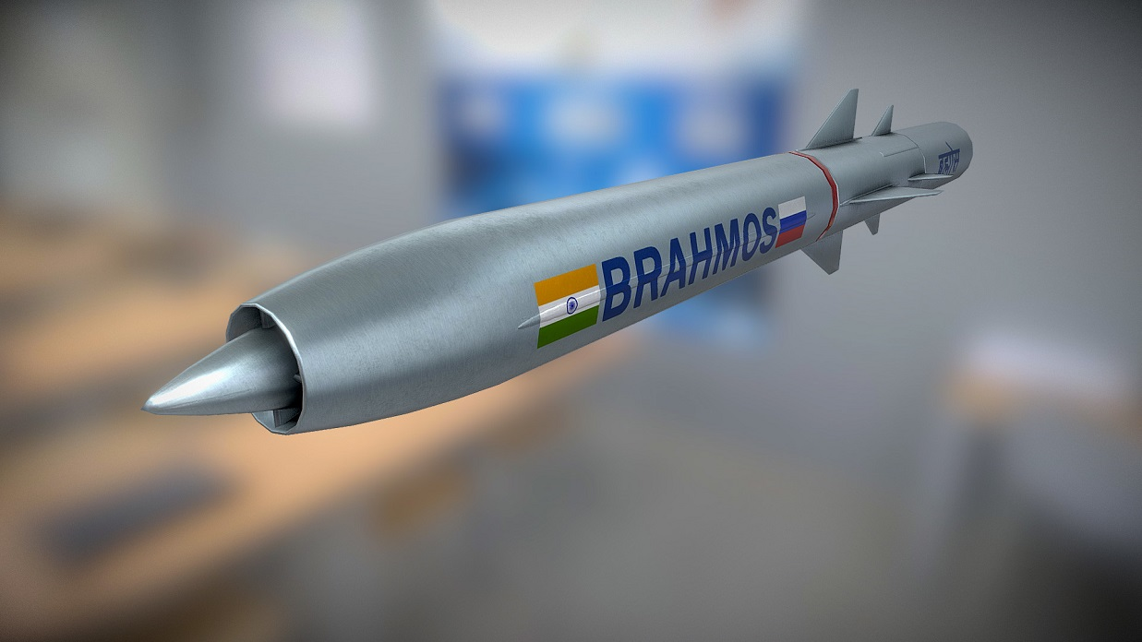
Mach 3+
Works in ramjet engine
Turbojet engines nested as ramjet can’t help the plane in taking off
SR71 Blackbird
Fastest and only supersonic missile on planet.
Breaks sound barrier by travelling three times faster than the speed of sound wave.(Mach 3)
Has solid boosters also, along with ramjet
BrahMos

Slide 10
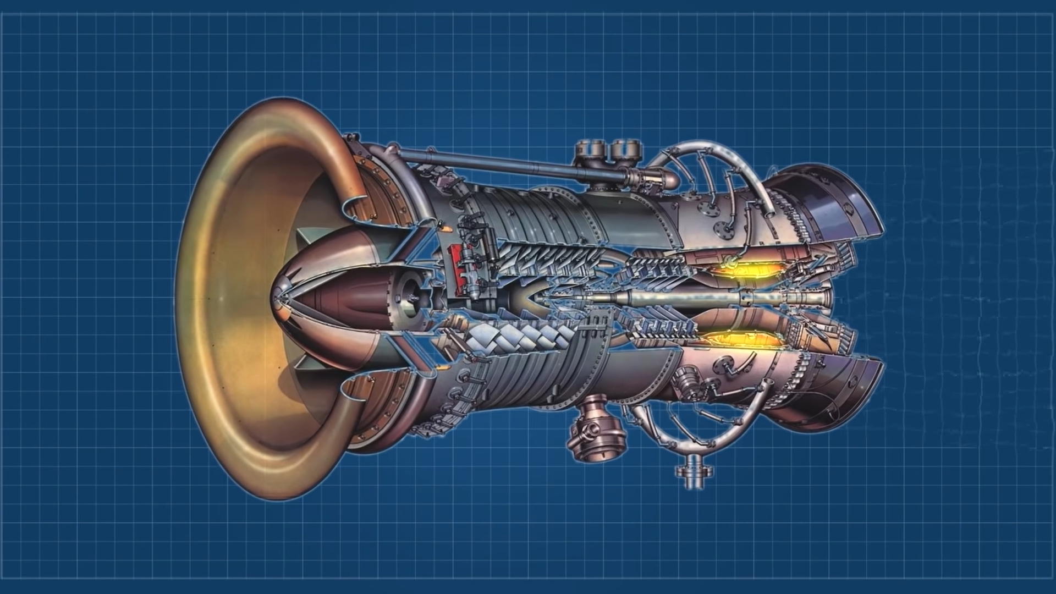
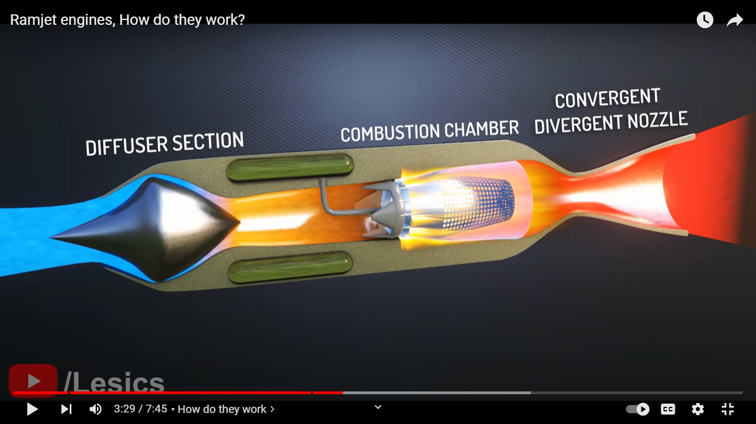
Ramjet Engines:
More like a rocket with a difference that they produce thrust once they have fast airflow to start working.
It doesn’t have blades like a turbine(very few moving parts).
It relays on its shape to slow down the supersonic air at the intake to a subsonic speed.

Slide 11
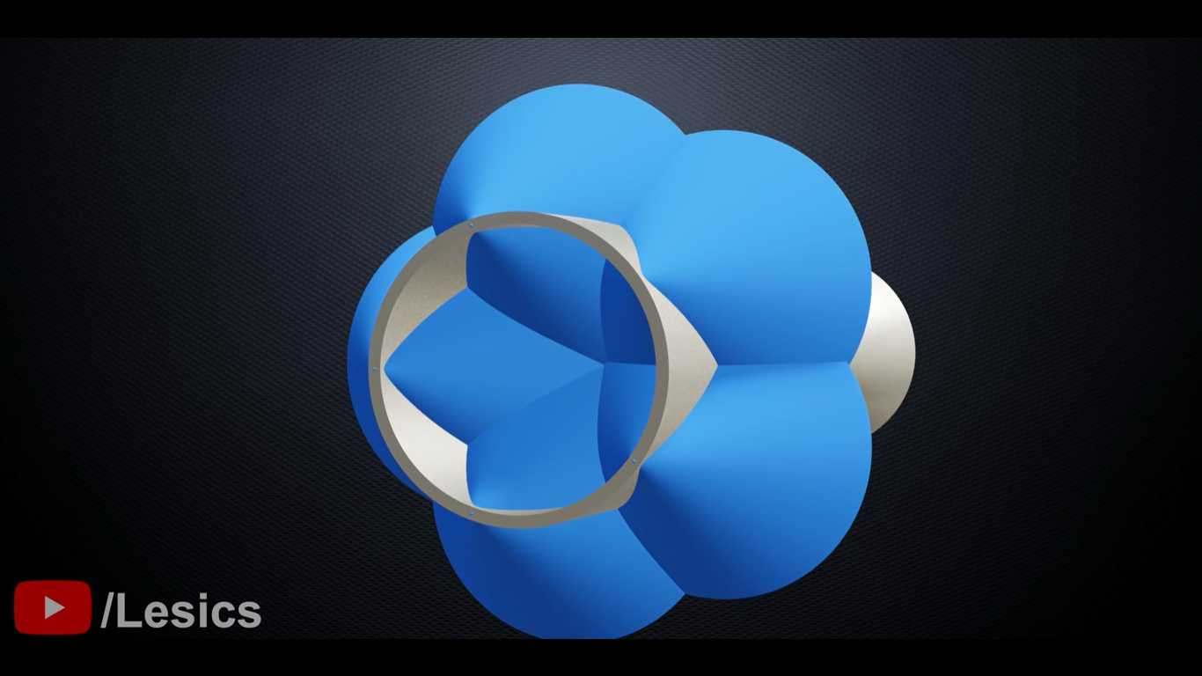


How Ramjet engines works?
Blue cones are Mach cones. Infinite of these cones results in the figure below. This is called Ram effect.
This high pressure and high temperature air can create effective combustion in combustion chamber. Hydrogen is commonly used as fuel in ramjets. Combustion chamber increases speed of air further.
To make this arrangement more effective a converging-diverging nozzle is added at last.

Slide 12
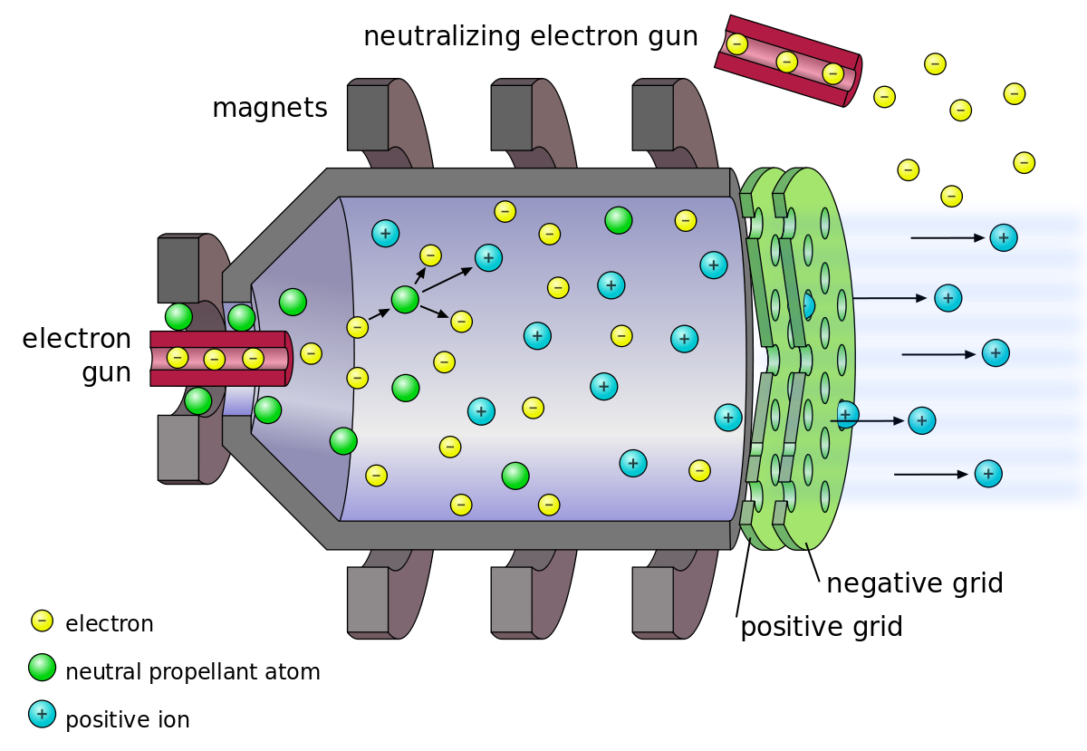
Ion Thrusters:
There is still far way to go in ion thrusters but this technology is not new to mankind. This is being used for about 50 years now.
How ions can generate thrust?
The gas that is used to generate ion should be of higher mass and inert in nature because it can be stored for high time period.
Now the energetic e hits the Xenon molecule and gets converted to Xe+ ion. So, apparently now Xe+ ion are moving outwards.
Now that we have created Xe+ ions which are moving out but since electrons are also present in the chamber which can result in Xe+ ion to again convert to Xe molecule. To prevent this, the big chamber contains magnetic rings which separated e- and Xe molecule in separate direction.
When Xe+ ion if thrown out of the chamber, it is clear possibility that Xe+ ion will get attracted to the outer plate, So to prevent this

Slide 13
